Slide 1

Onboarding Data Collection Quick Reference Guide
The purpose of this guide is to describe how to fill in the Personal and Additional Data Collection forms in SuccessFactors’ Onboarding portal.
User role: New Joiner

Slide 2
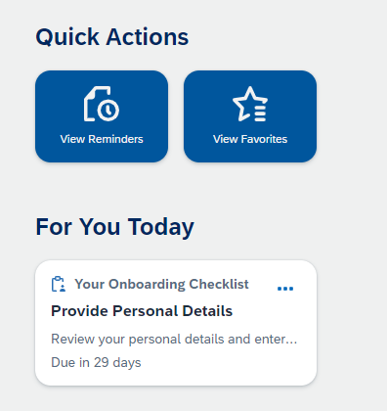
Onboarding Data Collection
Go to For You Today
Click on Provide Personal Details

Slide 3
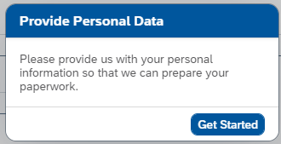
Personal Data Collection
Click on Get Started

Slide 4
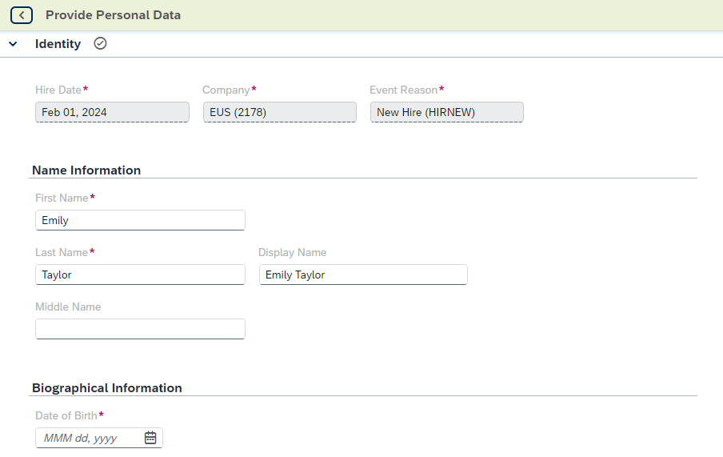
Personal Data Collection
Name Information
Validate and update when needed. Definitions
First Name: Your legal/given name
Last Name: Your family name/surname
Middle Name: Your second given name (when applicable)
Display Name: It will be used internally within Ericsson, in Outlook, Teams and in your business email address. The Display Name consists of the first name and last name unless a preferred name was provided in your application. If so, it replaces the first name. If an update of the preferred name is needed, this can be done further down in the data collection form.
Biographical Information: DOB is mandatory.
Please validate and fill when needed

Slide 5
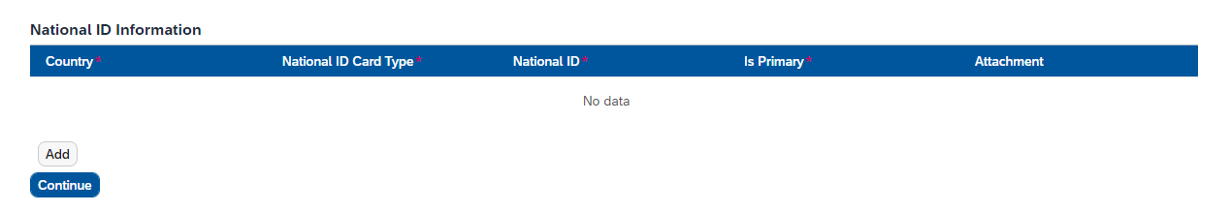
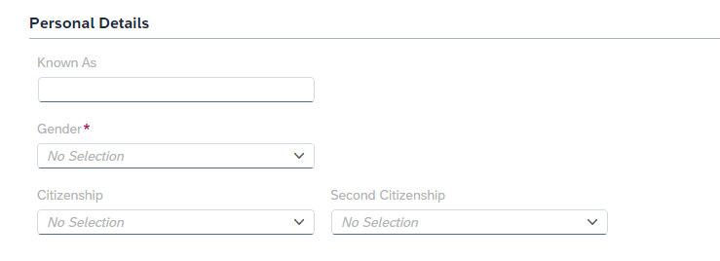

Personal Data Collection
National ID information:
To enter your national ID, click on the Add Button.
Click add button multiple times to fill out your Aadhar and Pan number information. This is Mandatory requirement and should be completed.
Click Continue to proceed to the next step.
Personal Details
Validate and update when needed
Definitions
Known As: Preferred Name; Enter only if you want a different name than your legal first name to be used internally in Ericsson (Outlook, Teams, business email etc.)
Citizenship: Citizenship of Country is mandatory

Slide 6
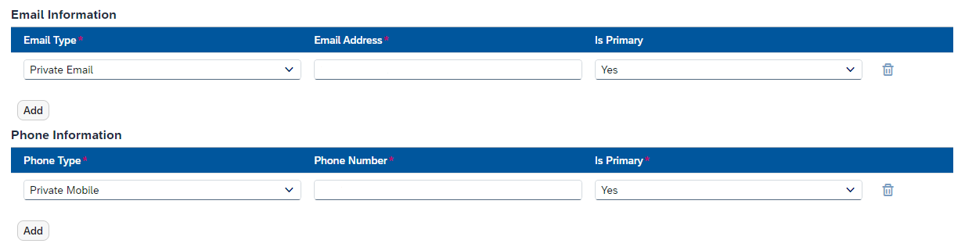
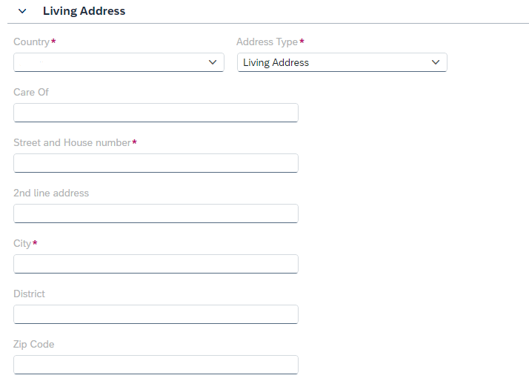
Personal Data Collection
Email & Phone Information
Please Validate and update private email and private mobile number.
Living Address
Please validate and update the complete living address along with PIN Code.

Slide 7
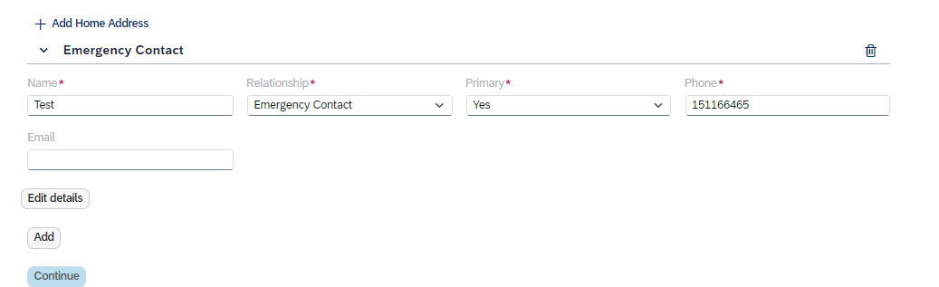
Personal Data Collection
Please click on Add Home Address and update your Original address along with Pin Code
Provide your Emergency Contact and click Continue

Slide 8
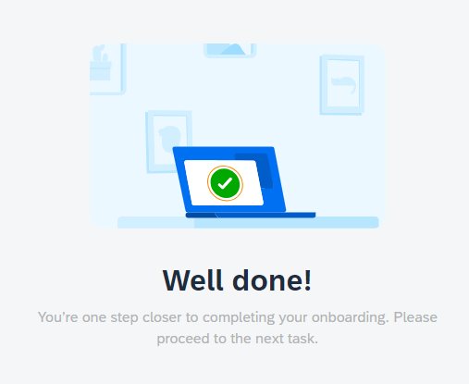

Personal Data Collection
Submit or Save your details
Click on Submit and Confirm once you have provided your information
or Save Draft if you want to continue later.

Slide 9
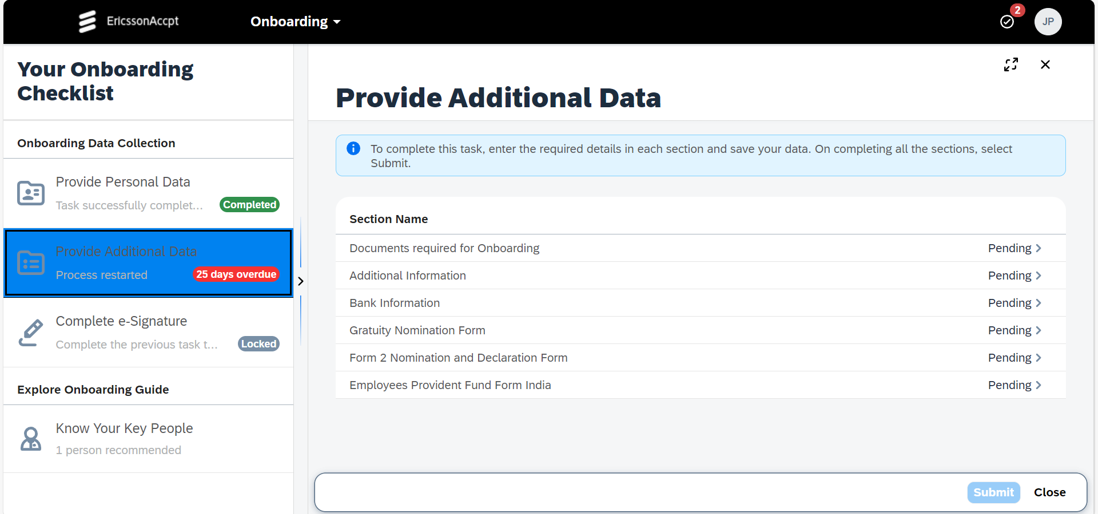
Additional Data Collection
Please complete each mentioed task to proceed further

Slide 10
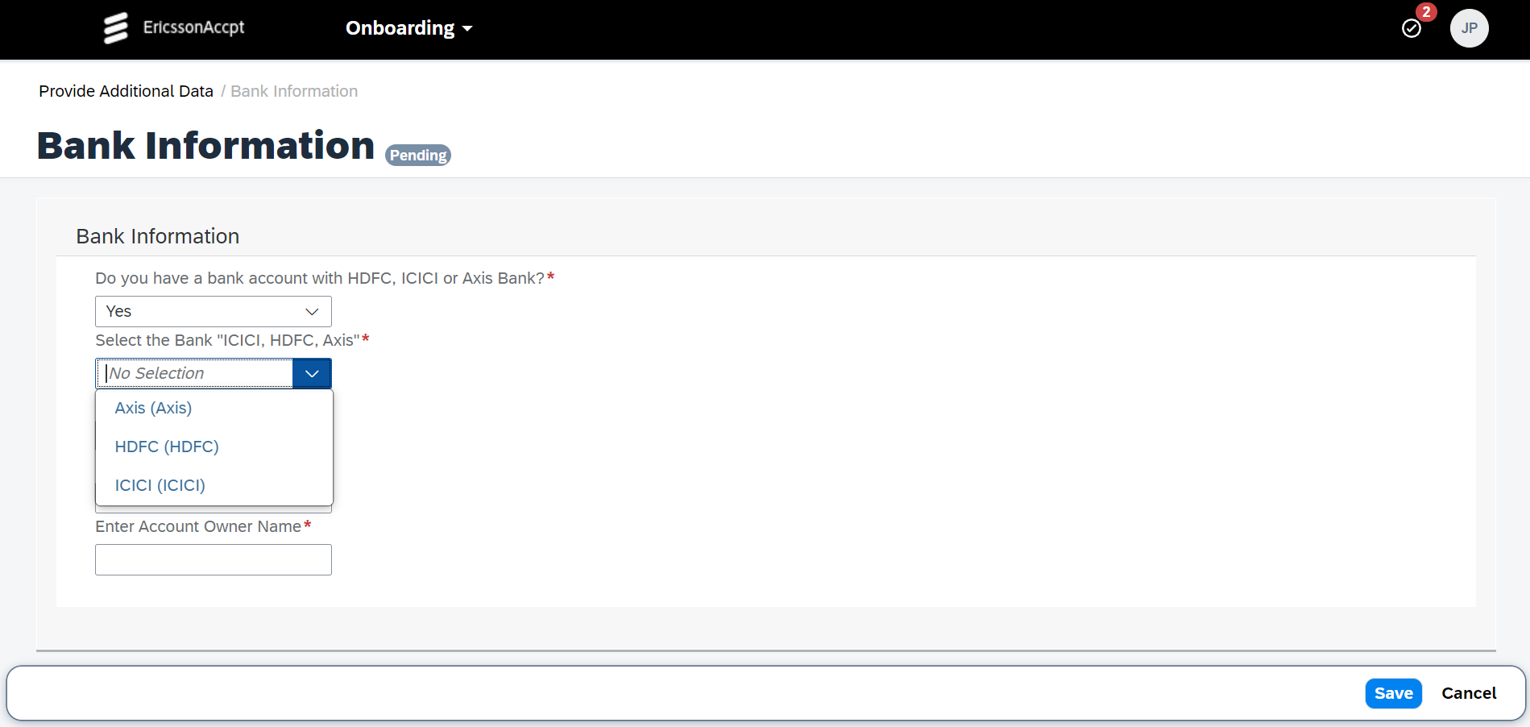
Additional Data Collection
Please share Bank info for Salary account if you don't have accounts from HDFC, AXIS & ICICI.
Choose preferred bank to open new account.

Slide 11
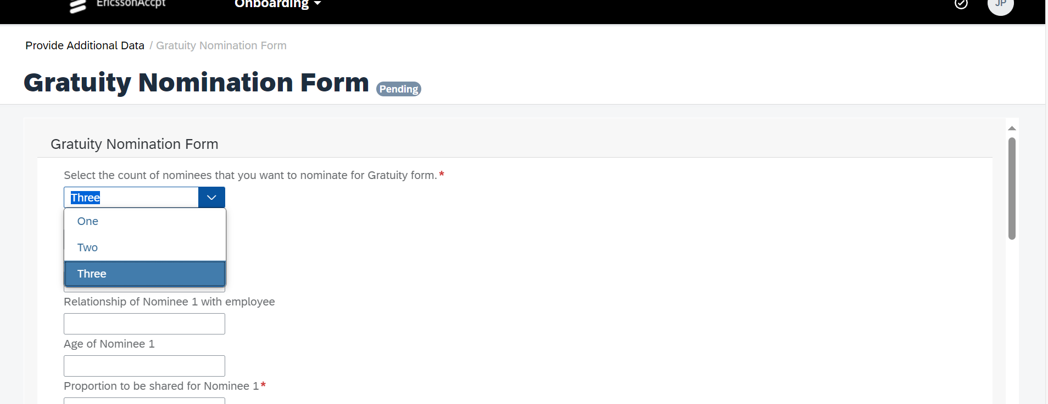
Additional Data Collection
Please fill out gratuity Nomination details as it is mandatory

Slide 12
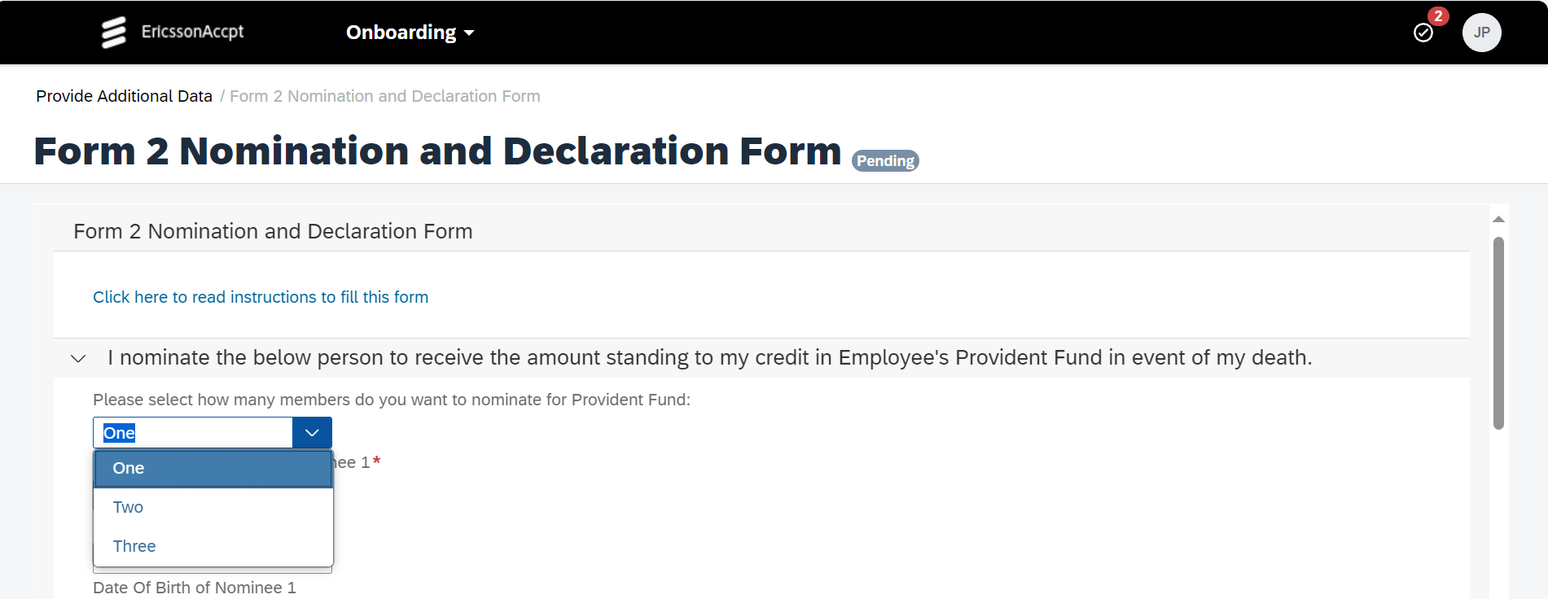
Additional Data Collection
As per statutory requirement every individual is required to declare the nomination, you are free to decide number of nominees uptill-3

Slide 13
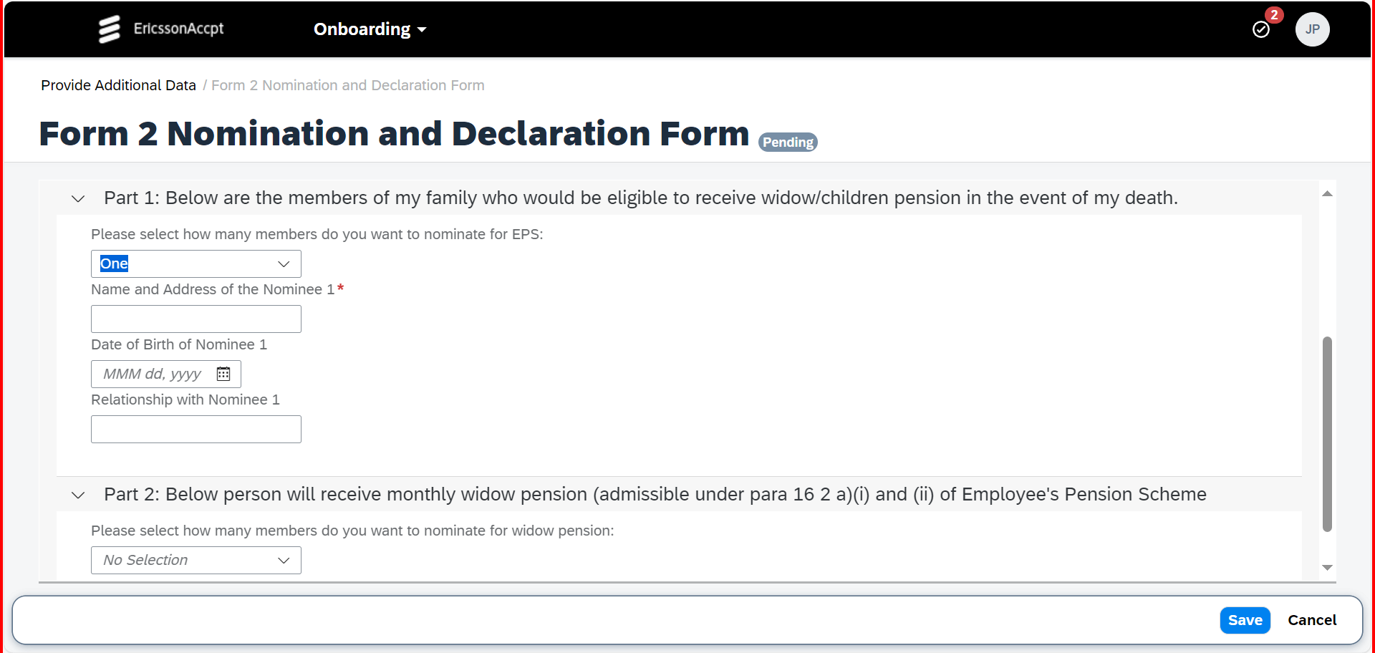
Additional Data Collection
Provide nominee details for EPS where if you are married then fill part 1 and if you are unmarried fill part 2.
EPS nomination are required to be filled as per statutory requirement

Slide 14
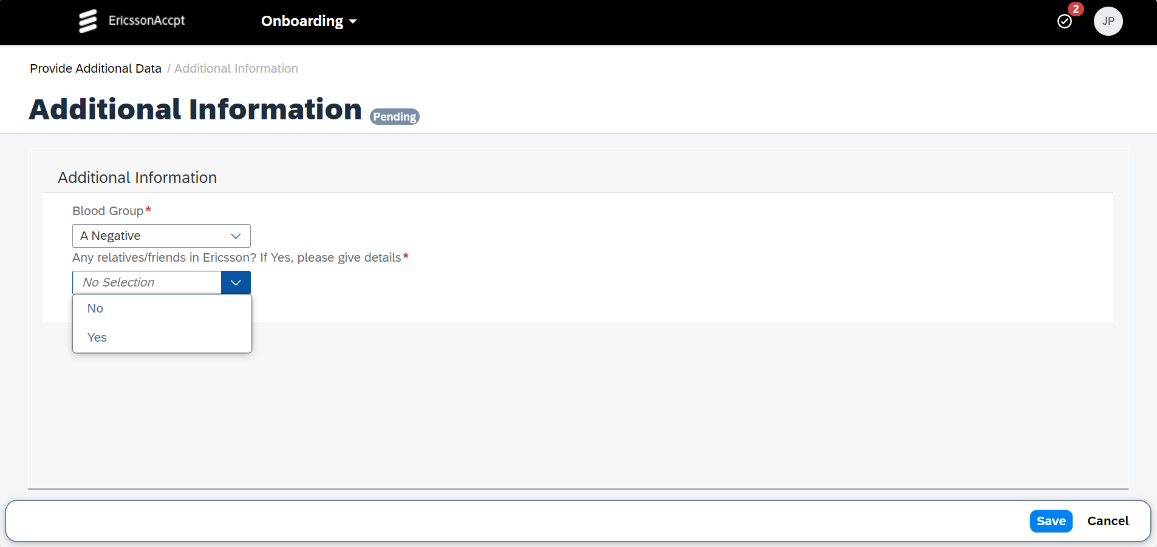
Additional Data Collection
Please provide your blood group and
Details of relatives in Ericsson, if any. If you opt Option Yes

Slide 15
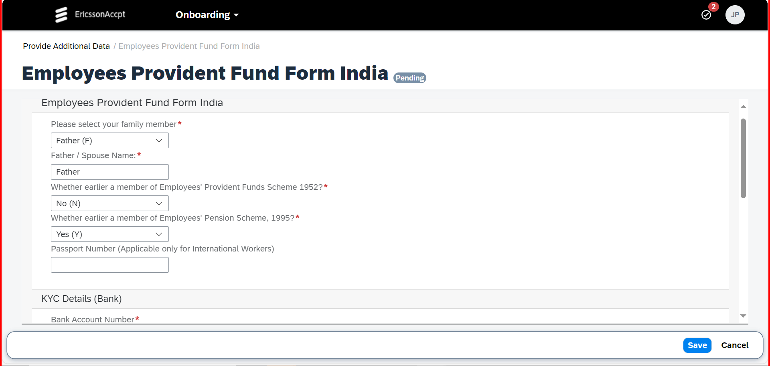
Additional Data Collection
Please provide the PF information if you are a member of provident fund scheme If not please select No and proceed.

Slide 16
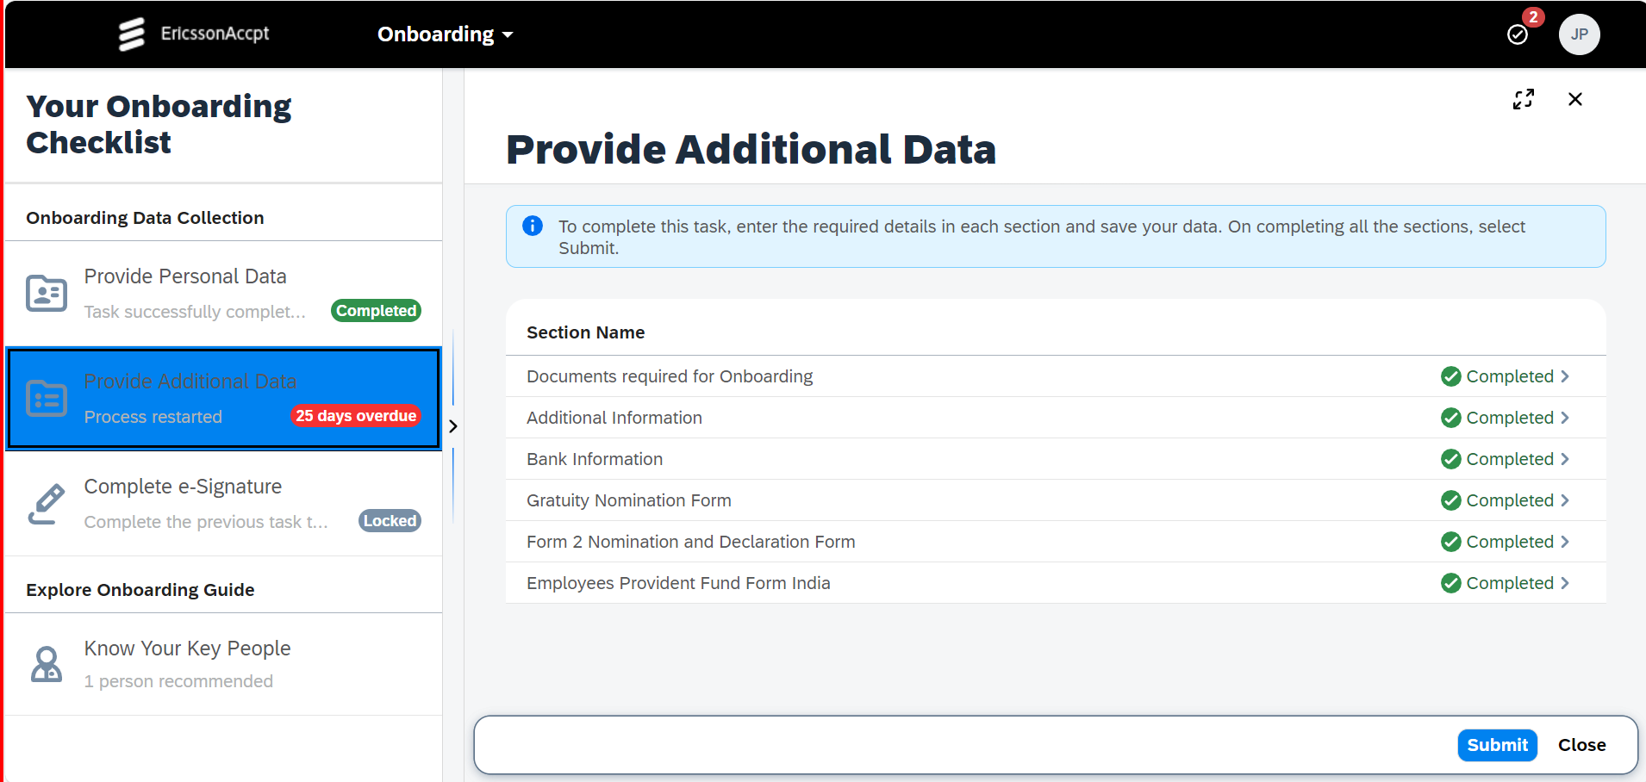
Additional Data Collection
Please click submit after getting green tick on all the documents checklist which you can see in Snip.

Slide 17
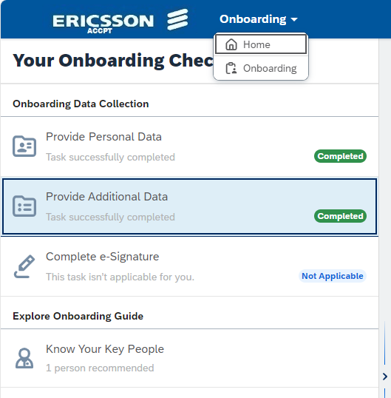
You are all set!
Thank you!
You have now finalized the Data Collection and you will get the mail for DocuSign the forms for your joining formalities and your Onboarding Single Point of Contact (SPOC) will also get in touch with you .after that you can proceed to the Home page, where you can familiarize yourself with content about Ericsson as an employer.

Slide 18
ericsson.com

